Slide 1
Platforms and tools for Web Services and Mobile Applications
Browser based Applications
Bent Thomsen
Aalborg University
3rd and 4th of June 2004

Slide 2
A Brief History of WAP
In 1995 the Internet became commercial.
  Rapid adoption rate (exponential).
  A new way to access information.
  Changed the way we do business (e-commerce).
  Changed the social fabric of society.
1997 phone manufacturers began experimenting with the mobile internet.
Around this time the concept of Mobile Commerce (M-Commerce) is coined.
Idea of M-Commerce is promoted world wide...

Slide 3



Formerly the WAP Forum
WAP Forum formed to address the standardization and interoperability issues that emerged.
Group consisting of representatives from various world wide organizations:
  Terminal (Phone) Manufacturers
  Network Operators
  Systems Developers (Microbrowsers & Operating Systems)
  Application Developers (WAP Applications)
World’s Experts in:
  Hardware, Software, Data Networks, Security & Future Internet visionaries
OMA - http://www.openmobilealliance.org/

Slide 4
WAP Standards Define...
Wireless Application Environment
  WML Microbrowser
  WMLScript Virtual Machine
  WMLScript Standard Library
  Wireless Telephony Application Interface
  WAP Content Types
Wireless Protocols
  Wireless Session Protocol (WSP)
  Wireless Transport Layer Security (WTLS)
  Wireless Transaction Protocol (WTP)
  Wireless Datagram Protocol (WDP)
  Wireless network interface definitions

Slide 5
Comparing WAP and The Web
Many Web concepts adopted to WAP environment
WAP uses the existing Web protocols (HTTP)
Wireless Markup Language (WML) is similar to Hypertext Markup Language (HTTP)
Support for similar functionality that is available in regular browsers:
  Without color, animation, sound, frames & other…
  Specification is open to future growth
Both support security and access control models
Both are difficult to understand by beginners
Think of WAP as 1st generation of Internet (e.g. gopher)

Slide 6

WAP Architecture
Client
Web Server
WAP Gateway
WML
WML Encoder
CGI
Scripts
etc.
WML-Script
WSP/WTP
HTTP
WMLScript
Compiler
WML Decks
with WML-Script
WTAI
Protocol Adapters
Content
Etc.
Source: WAP Forum

Slide 7
HTML/WML Document Processing
Internet
Wireless network
<HTML>
<HEAD>
<TITLE>RAT SYSTEMS.COM</TITLE>
<META HTTP-EQUIV="Refresh" CONTENT="1800, URL=/index.html">
</HEAD>
<BODY BGCOLOR="#FFFFFF" BACKGROUND="/images/9607/bgbar5.gif" LINK="#0A3990" ALINK="#FF0000" VLINK="#FF0000" TEXT="000000" ONLOAD="if(parent.frames.length!=0)top.location='http://nnn.com';">
<A NAME="#top"></A>
<TABLE WIDTH=599 BORDER="0">
<TR ALIGN=LEFT>
<TD WIDTH=117 VALIGN=TOP ALIGN=LEFT>
<WML>
<CARD>
<DO TYPE="ACCEPT">
<GO URL="/submit?Name=$N"/>
</DO>
Enter name:
<INPUT TYPE="TEXT" KEY="N"/>
</CARD>
</WML>
WAP/WML
HTTP/HTML
Content encoding
<HTML>
<HEAD>
<TITLE>NNN Interactive</TITLE>
<META HTTP-EQUIV="Refresh" CONTENT="1800, URL=/index.html">
010011010011110110010011011011011101010010011010

Slide 8
Web & WAP Decomposition
Internet
HTML
JavaScript
Wireless Application
Environment (WAE)
Future Services and
Applications
Session Layer (WSP)
HTTP
Transaction Layer (WTP)
TLS - SSL
Security Layer (WTLS)
Transport Layer (WDP)
TCP/IP
UDP/IP
Bearers:
SMS
USSD
GSM
IS-136
CDMA
CDPD
GPRS
Etc..
Web
WAP

Slide 9
WAP Application Environment
(WAE)

Slide 10
WAE is for Developers
Network independent application development environment
Designed to be flexible and interoperable
Targets narrowband devices such as phones and personal digital assistants (PDA)
It is device independent
Based upon a well established Web programming model
Fits into existing Internet infrastructure
Open to future evolution of underlying technologies

Slide 11
WAE Defines
High Level System Architecture
  Application development model
  Browser, Gateway, Content Server integration
Display language
  Content Markup Language (WML)
  Image format (Wireless Bitmap format)
Scripting language
  WMLScript: syntax similar to ECMAscript (JavaScript like)
  Virtual Machine capabilities
  Supporting libraries
Telephony Services API and architecture
  Integration of Voice calls with Data access

Slide 12
Wireless Markup Language
Tag-based browsing language:
  Screen management (layout, text, images,..)
  Data input (text, selection lists, etc.)
  Hyperlinks & navigation support
W3C XML-based language
  Guarantees well formed document
  Future plans for XHTML compatibility
Based on Phone.com’s Handheld Markup Language (HDML) and W3C’s HTML

Slide 13
WML Concepts
Card/Deck Development Metaphor:
  A Deck consists of one or more cards
  Cards are viewable one at a time
  User navigation between cards is local
  Movement between decks requires an interaction with a server (fetch deck)
Card Content:
  Text rendering and Image layouts
  Timer and user interaction events
  Navigation uses hyperlink style URLs

Slide 14
WML Concepts (cont.)
MicroBrowser Related:
  Special menu options (Options)
  History of navigation (Back button)
  Softkeys (special quick action buttons)
  Bookmarking facilities
  State management (context) and variables storage facility
  Caching support for quicker processing

Slide 15
WML and Deck Format
WML Document prologue:
  Document type and XML Version
  Prepares parsing engine to interpret deck according to Document Type Definition (DTD)
  Markup begins with <WML> tag and concludes with </WML>
Note:
  WML source must be compiled into binary format by gateway before forwarding to device (phone)
  Emulators and some PDAs can process WML source without compilation if they have a WML parser

Slide 16
A Simple WML File
A Simple WML file
Standard header for WML 1.1 files
<?xml version='1.0'?>
<!DOCTYPE wml PUBLIC "-//WAPFORUM//DTD WML 1.1//EN" "http://www.wapforum.org/DTD/wml_1.1.xml">
<wml>
<card id="First_Card" title="First Card">
<p>
Welcome to WML!
</p>
</card>
</wml>

Slide 17
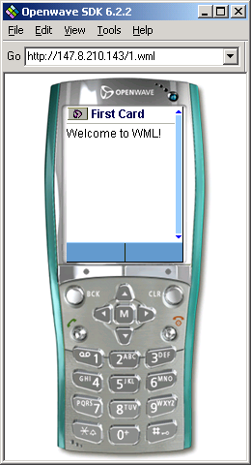

Slide 18
A WML Deck Breakdown
<WML>
<CARD>
<DO TYPE=“ACCEPT”>
<GO URL=“#eCard”/>
</DO
Welcome!
</CARD>
<CARD NAME=“eCard”>
<DO TYPE=“ACCEPT”>
<GO URL=“/submit?N=$(N)&S=$(S)”/>
</DO>
Enter name: <INPUT KEY=“N”/>
Choose speed:
<SELECT KEY=“S”>
<OPTION VALUE=“0”>Fast</OPTION>
<OPTION VALUE=“1”>Slow</OPTION>
<SELECT>
</CARD>
</WML>
Navigation
Card
Variables
Deck
Input
Elements

Slide 19
WML Elements
Just like HTML, there are some predefined WML elements that you can use.
Examples of elements:
  Deck/Card Elements
    wml card template head access meta
  Tasks
    go prev refresh noop
  Variables
    setvar
  User input
    input select option optgroup fieldset
  Anchors, Images, and Timers
    a anchor img timer
  Text formatting
    br p table tr td

Slide 20
Special WML Character Support
Use character entities to display the following text:
&quot; "
&amp; &
&apos; '
&lt; <
&gt; >
&nbsp; Blank space
&shy; Soft hyphen (discretionary line break)
In URLs Replace the “&” character:
URL="query.cgi?first=$fname&amp;last=$lname”
Use “$$” to display a single “$” character
Note: Incorrect characters may hang/crash/lock a WAP device

Slide 21
Deck/Card Elements
A deck is a single WML document (the elements contained within the <wml> document element).
A card is a single interaction between a user agent and a user.
This allows multiple screens to be downloaded to the client in a single retrieval.

Slide 22
A WML Example with Cards
<?xml version='1.0'?>
<!DOCTYPE wml PUBLIC "-//WAPFORUM//DTD WML 1.1//EN" "http://www.wapforum.org/DTD/wml_1.1.xml">
<wml>
<card id="Login" title="Login">
<do type="accept" label="Password">
<go href="#Password"/>
</do>
<p>
UserName:
<select name="name" title="Name:">
<option value="Charlene">Charlene</option>
<option value="Gillian">Gillian</option>
<option value="Rosanne">Rosanne</option>
<option value="Race">Race</option>
</select>
</p>
</card>
Login Card - the first card here
Go to Password card when user selects it
Select menu – a common control in WML

Slide 23
(continued from previous slide)
<card id="Password" title="Password:">
<do type="accept" label="Results">
<go href="#Results"/>
</do>
<p>
Password: <input type="text" name="password"/>
</p>
</card>
<card id="Results" title="Results:">
<p>
You entered:<br/>
Name: $(name)<br/>
Password: $(password)<br/>
</p>
</card>
</wml>
The Password card
The Results card

Slide 24
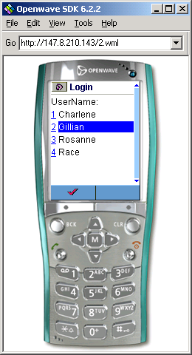
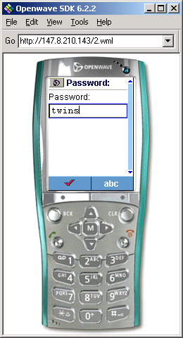
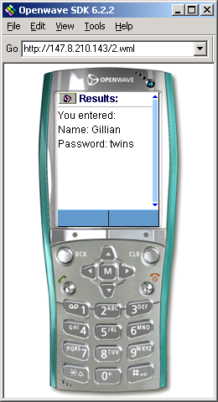
Login card
Password card
Results card

Slide 25
Server Transactions
WML can be used to perform server/database transaction through other server programming languages (such as ASP, PHP, JSP and Servlets).
Allows WML to contain dynamic, customized content.

Slide 26
A WML/ASP Example
<?xml version='1.0'?>
<!DOCTYPE wml PUBLIC "-//WAPFORUM//DTD WML 1.1//EN" "http://www.wapforum.org/DTD/wml_1.1.xml">
<wml>
<card id="Vote" title="Artist Voting">
<p>
<select name="Artist" title="Artist">
<option value="Charlene">Charlene</option>
<option value="Gillian">Gillian</option>
<option value="Rosanne">Rosanne</option>
<option value="Race">Race</option>
</select>
</p>
<do type="accept" label="Query">
<go href="votes.asp" method="get">
<postfield name="Artist" value="$(Artist)"/>
</go>
</do>
</card>
</wml>
Send a get request to an ASP page

Slide 27
Retrieve data from the get query
<%
Dim output
If Request.QueryString("Artist") = "Charlene" Then
output = "You selected Charlene!"
ElseIf Request.QueryString("Artist") = "Gillian" Then
output = "You selected Gillian!"
ElseIf Request.QueryString("Artist") = "Rosanne" Then
output = "You selected Rosanne!"
ElseIf Request.QueryString("Artist") = "Race" Then
output = "You selected Race!"
End If
Response.ContentType = "text/vnd.wap.wml"
%>
<?xml version='1.0'?>
<!DOCTYPE wml PUBLIC "-//WAPFORUM//DTD WML 1.1//EN" "http://www.wapforum.org/DTD/wml_1.1.xml">
<wml>
<card id="Results" title="Results">
<p>
<%Response.write(output)%>
</p>
</card>
</wml>
Other database codes can be put here
Sets the response MIME type to be WML
Write content of the WML page

Slide 28
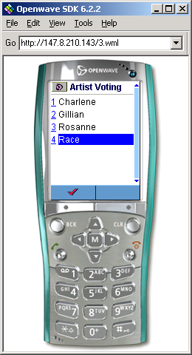
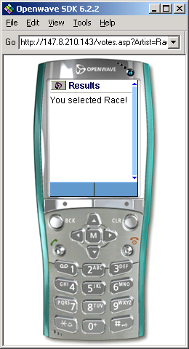

Slide 29
Current WML Restrictions
Compressed WML deck must not be larger than 1.4K
WAP Devices are not 100% WML compliant therefore testing on physical devices is required
Rendering of WML on some microBrowsers makes navigation difficult
  Developing WML specific for each device may be necessary. This breaks the core concept behind device independence but is a sad reality
Cache Problems are common
  Cached documents do not always expire OR always expire
  Need to employ “trick” to expire them - Use long URLs
  No assumptions can be made about cached documents/images
Meta tags in head is not always supported
Some devices do not support POST, only GET operations
Device capabilities can not be established
  Use UserAgent tag to establish device type and its capabilities (not easy)

Slide 30
Advanced WML
Templates
  Define common look and feel across cards
  User interface consistency
Timers for:
  Page Refreshes - Refresh Stock price
  Animation - display a sequence of cards with a different image per card. Loop this and you have animation
Variables:
  Personalization and content adaptation
Many other creative possibilities...

Slide 31
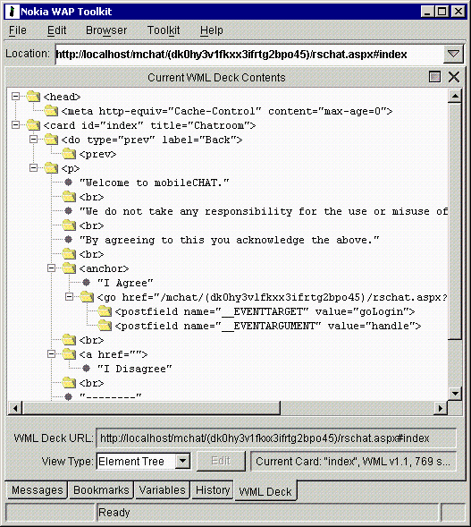
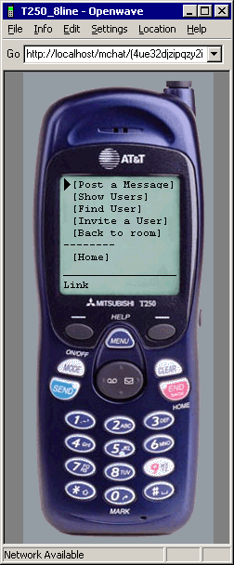
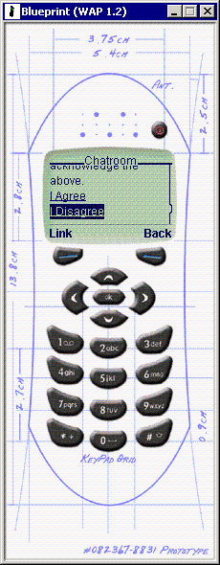
WAP Development Environment

Slide 32
Developing Wireless Apps
Stage 1: Development
  Design User Interface aspects
  Select development platform/language:
    Microsoft.NET, ASP, ColdFusion, Java Servlets, Perl, etc.
  Write Code behind the interface
  Test application in Emulators
Stage 2: Testing
  Test application scalability by simulating multiple clients
  Test application on a series of WAP devices
Step 3: Deployment
  Integrate into existing WAP Portal content on site
  Configure server for access restrictions
  Check the server log files to see service popularity

Slide 33
WML Script

Slide 34
WMLScript
Scripting language:
  Procedural logic, loops, conditionals, etc.
  Optimized for small-memory, small-cpu devices
Derived from ECMAscript
Integrated with WML:
  Powerful extension mechanism
  Reduces overall network traffic
  Mobile Code architecture

Slide 35
WMLScript (cont.)
Bytecode-based virtual machine:
  Stack-oriented design
  ROM-able
  Designed for simple, low-impact implementation
Source Code Compiler in WAP Gateway:
  Better network bandwidth use
  Better use of phone memory/cpu

Slide 36
WMLScript API Libraries
Available on all WAP compatible devices:
  Lang - VM constants, general-purpose math functionality
  String - String processing functions
  URL - URL processing
  Browser- WML browser interface
  Dialog - Simple user interface
  Float - Floating point functions
Other libraries are available as proprietary extensions on device

Slide 37
Common WMLScript Uses
Reduce network round-trips and enhance functionality
Field validation
  Check for formatting, input ranges, etc.
Device extensions
  Access device or vendor-specific API
Conditional logic
  Download intelligence into the device as needed

Slide 38
Example ECMAScript
Functions
function currencyConvertor(currency, exchRate) {
return currency*exchangeRate;
}
function myDay(sunShines) {
var myDay;
if (sunShines) {
myDay = “Good”;
} else {
myDay = “Not so good”;
};
return myDay;
}
Variables
Programming
Constructs

Slide 39
WAP Telephony Application
(WTA)

Slide 40
WTA Overview
Tools for building telephony applications within the WAP environment
Designed primarily for:
  Network Operators / Carriers
  Equipment Vendors
  Developers

Slide 41
WTA Overview (cont.)
WTA Browser
  Extensions added to standard WML/WMLScript browser
  Exposes additional API (WTAI)
WTAI includes:
  Call control
  Network text messaging
  Phone book interface
  Indicator control
  Event processing
WTAI access is available from WML & WMLScript.

Slide 42
Placing an outgoing call with WTAI: in WML
<WML>
<CARD>
<DO TYPE=“ACCEPT”>
<GO URL=“wtai:cc/mc;$(N)”/>
</DO>
Enter phone number:
<INPUT TYPE=“TEXT” KEY=“N”/>
</CARD>
</WML>
WTAI Call
Input Element

Slide 43
Placing an outgoing call with WTAI: in a WMLScript function
function checkNumber(N) {
if (Lang.isInt(N))
WTAI.makeCall(N);
else
Dialog.alert(“Bad phone number”);
}
WTAI Call

Slide 44
Benefits of WTA
Integration of Telephony Application Interface into mobile applications
Automatic activation of Voice call by user action or WAP site application
More call control features are yet to become available for greater call management

Slide 45
WAP Summary
WAP is the 1st generation of the mobile Internet
M-commerce is just beginning
Powerful framework for extending mobile device capabilities through WAP applications
Numerous development issues exist due to technology immaturity
WAP is sufficient for adoption by Internet generation only Still too complicated for the majority of users
WAP is rapidly improving each year - color, music, etc
WAP future is uncertain given the improvements in device capabilities – xHTML is looking more appealing

Slide 46
XHTML-MP

Slide 47
Do we REALLY have to Learn Another New Language?
WML is similar to HTML, yet different
Takes time to learn each new language
Solution: The new standard is XHTML Mobile Profile
Contains: Subset of XHTML (which is an XML version of HTML) and some of wml 1.0

Slide 48
XHTML-MP
XHTML-MP: eXtensible HTML Mobile Profile
The new official mark-up language of WAP 2.0
Evolved from WML, HTML and cHTML (Compact HTML mainly used in Japan)
Getting more popular in new mobile devices, especially 3G ones.
Format more similar to HTML; easier for HTML programmers to learn.
Can use Cascading Style Sheets (CSS).

Slide 49
A Sample XHTML-MP Page
<?xml version="1.0"?>
<!DOCTYPE html PUBLIC "-//OPENWAVE//DTD XHTML Mobile 1.0//EN" "http://www.openwave.com/DTD/xhtml-mobile10.dtd">
<html xmlns="http://www.w3.org/1999/xhtml" xml:lang="en">
<head>
<title>XHTML Samples</title>
</head>
<body>
<ol>
<li><a accesskey="1" href="inbox.html">Check emails</a></li>
<li><a accesskey="2" href="movies.html">Movies Info</a></li>
<li><a accesskey="3" href="about.html">About</a></li>
</ol>
</body>
</html>
Quick access key

Slide 50
A Sample XHTML-MP Page
<?xml version="1.0" encoding="UTF-8"?>
<!DOCTYPE html PUBLIC "-//OPENWAVE//DTD XHTML Mobile 1.0//EN"
"http://www.openwave.com/dtd/xhtml-mobile10.dtd">
<html xmlns="http://www.w3.org/1999/xhtml" xml:lang="en">
<head>
<title>
About this Site
</title>
</head>
<body>
<p>
This is a test site.
</p>
<hr/>
</body>
</html>

Slide 51
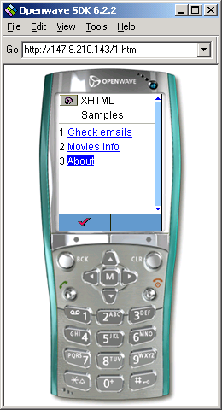
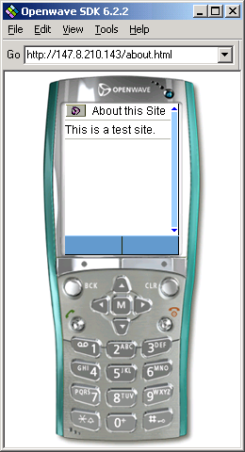

Slide 52
XHTML-MP
XHTML-MP is supposed to replace WML in WAP 2.0; however, many programmers still stick to WML.

Slide 53
I-Mode versus WAP
Developed by Nippon Telephone & Telegraph (NTT) Network Operator in Japan
NTT DOCOMO provides I-Mode access
Proprietary version of the Mobile Internet
Not compatible with WAP
More like a compact version of Web (cHTML)
Most popular mobile Internet data service in the world - 15+ Million subscribers
WAP & I-Mode will eventually merge into a unified standard markup language

Slide 54
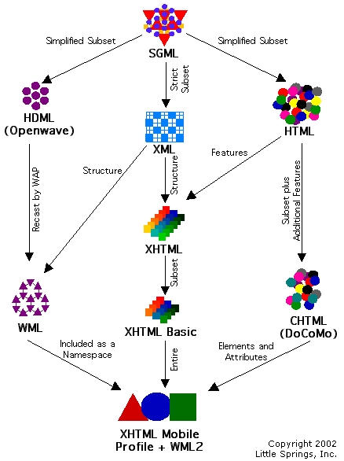
Standards
Evolution
http://www.littlespringsdesign.com/design/xhtmlinfo.html

